Slide 1

Discussion Session Biomedical Foundation Models integration into TBDSS

Slide 2

AGNEDA
1. ABOUT GENEFORMER
2. ABOUT SC-FOUNDATION
3. DISCUSSION SESSION

Slide 3
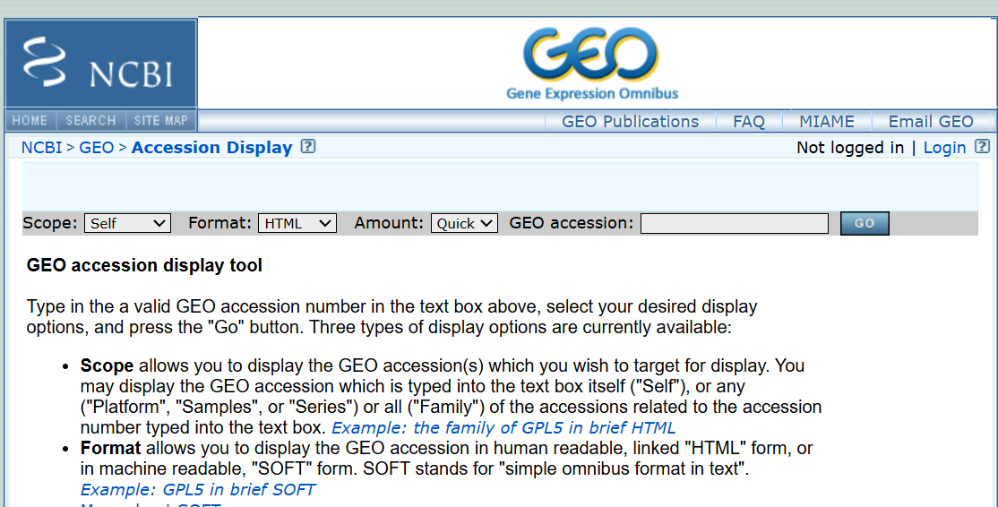
GENEFORMER’S INPUT DATA
txt.gz
.h5ad
.dataset
Source GEO Accession viewer
Only publically available format
Find datasets using GEO Ids
Cell annotation File + Raw Count Matrix
Cell annotation + Raw Count matrix
14 GB
Conversion time – 5mins
Standard hugging face Format
350 MB
Geneformer’s rank value Encoding
Final input to Geneformer
.loom
Cell annotation + Raw Count matrix
3 GB
Conversion time – 10 mins (sometimes crash)
 | CELL 1 | CELL 2 | CELL 3
Gene 1 | 10 | 0 | 0
Gene 2 | 20 | 30 | 50
Gene 3 | 0 | 50 | 60

Slide 4
PERTURBATION ANALYSIS SAMPLE WORKFLOW
PERTURBATION
Select dataset
Train it on a classification task
(2-3 hrs)
Delete or overexpress
Select gene or gene pairs
Source cluster , target : clusturs
Define classification task
Pairs (eg gene1 , gene2) in all cells | 1- 2 Hrs
All genes Perturbing 1 at a time Analyzed in 100 cells | 7 hrs
FINE TUNED WEIGHTS (1-2 mins)
Pretrained or Fine-Tuned
Interpret results
(Cosine Similarity value)
GENERATE CLUSTERS
Pretrained weights (1-2 mins)

Slide 5
ScFOUNDATION’S INPUT DATA
txt.gz
.h5ad
.dataset
Source GEO Accession viewer
Only publically available format
Find datasets using GEO Ids
Cell annotation File + Raw Count Matrix
Cell annotation + Raw Count matrix
14 GB
Conversion time – 5mins
S
3

